Slide 1
Air Quality Data Visualization & Insight Storytelling
Assignment 2B • Three charts, three insights, one narrative
Dataset: Cleaned air-quality dataset
Records analyzed: 9,357
Time period: 10 Mar 2004 – 04 Apr 2005
Objective: Turn raw measurements into decision-useful visual insights.
Narrative: Problem → Data → Insight → Action

Slide 2
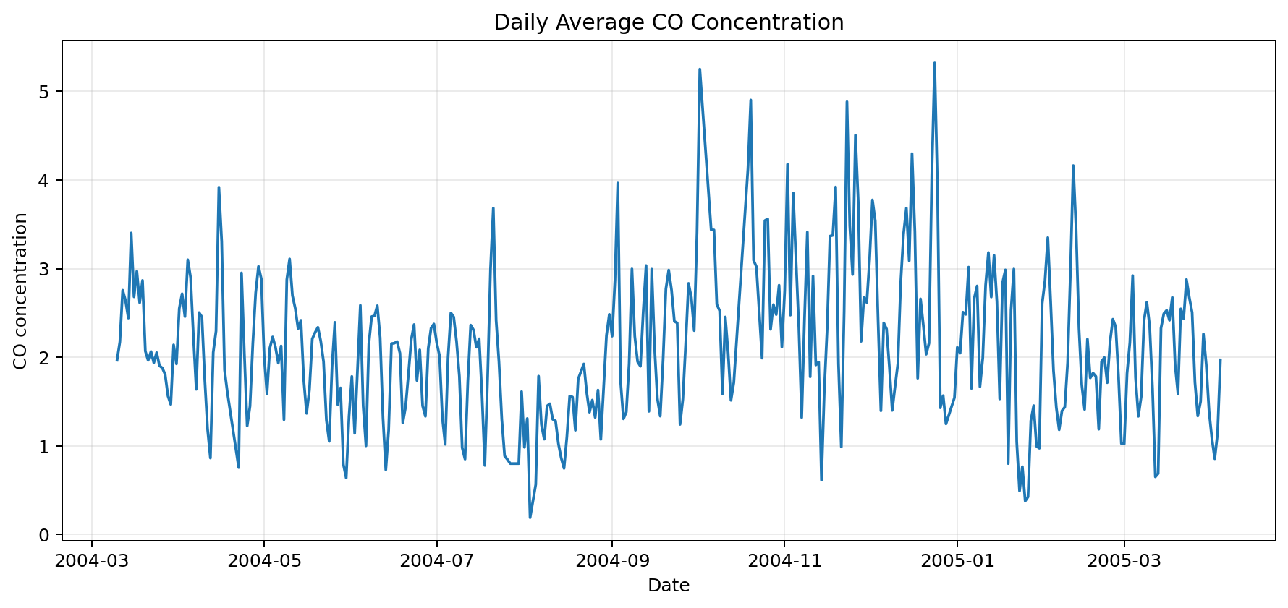
1. Trend: How CO changes over time
Daily average CO concentration
CO varies noticeably over time, with the highest daily average around 24 Dec 2004. This suggests air-quality conditions are not constant and should be monitored over time.

Slide 3
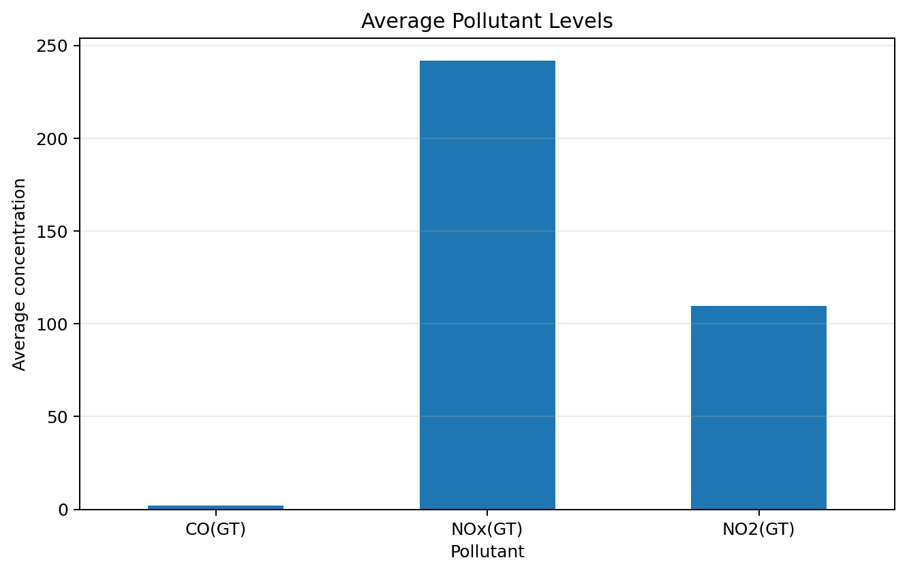
2. Comparison: Which pollutant stands out?
Average levels across selected pollutant measurements
KEY INSIGHT
NOx(GT) has the highest average recorded level (241.92) among the selected pollutants, making it the most prominent pollutant in this dataset.
Action: Prioritize the highest-average pollutant for closer monitoring and investigation.

Slide 4
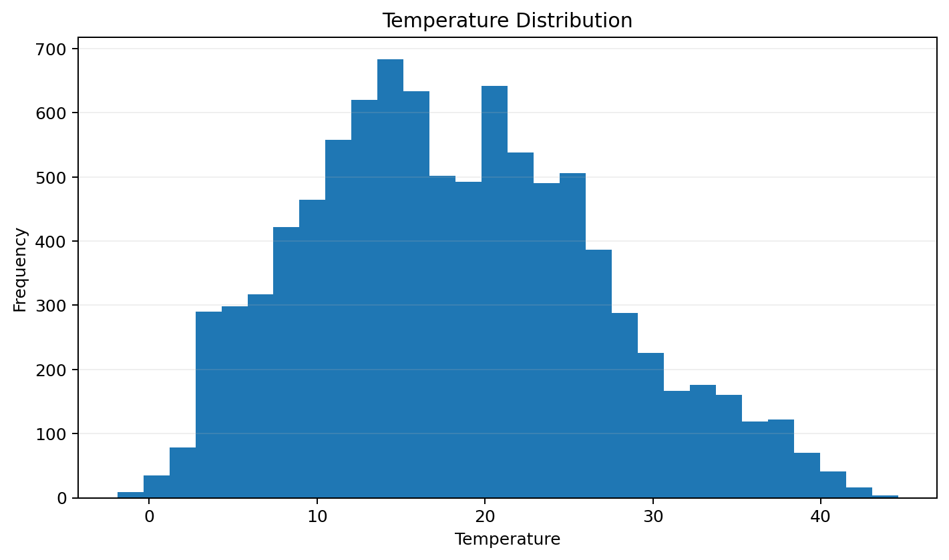
3. Distribution: What is the typical temperature range?
Frequency distribution of recorded temperature
KEY INSIGHT
Temperature is centered around a median of 17.60, with the middle 50% of observations falling between 11.70 and 24.30. The distribution shows the typical operating range of the dataset.

Slide 5
Narrative & Recommendations
Connecting the three visualizations into one decision story
PROBLEM
Air-quality measurements change over time, so a single snapshot may hide important variation.
DATA
The cleaned dataset contains timestamped pollutant and temperature measurements.
INSIGHT
CO changes across the period; one pollutant has the highest average level; temperature has a recognizable typical range.
WHAT COULD BE DONE
Monitor pollutant trends regularly, investigate periods of elevated pollution, and use temperature context when interpreting air-quality changes.

